Slide 1


Song Popularity on Spotify and YouTube
Group 3: Mirtha, Haley, Nicholas & Edward

Slide 2
Project Overview
We were contacted by two large streaming services, Spotify and Youtube.
Spotify is a streaming service.
YouTube is an online video sharing platform.
We were asked to determine what makes a song/artist popular on Spotify or YouTube.

Slide 3
Methods
Numerical
Defined functions to create plots.
Isolated numerical variables.
Created scatter plots for each variable compared to both Views and Streams.
Categorical
Created function for multi use.
Created groups of variables representing categorical columns.
Grouped by category columns.

Slide 4
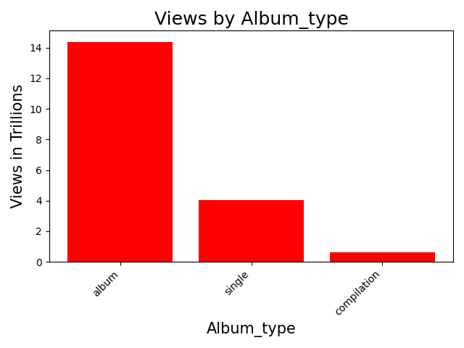
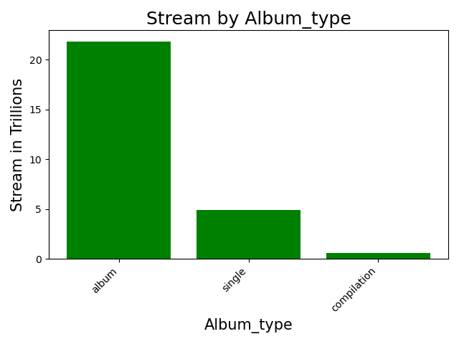
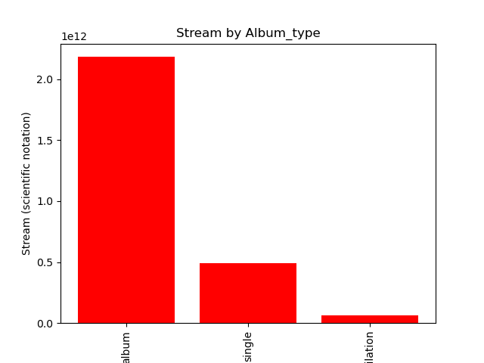
Does album type affect song popularity on both platforms?
Songs do better if they are part of an album

Slide 5
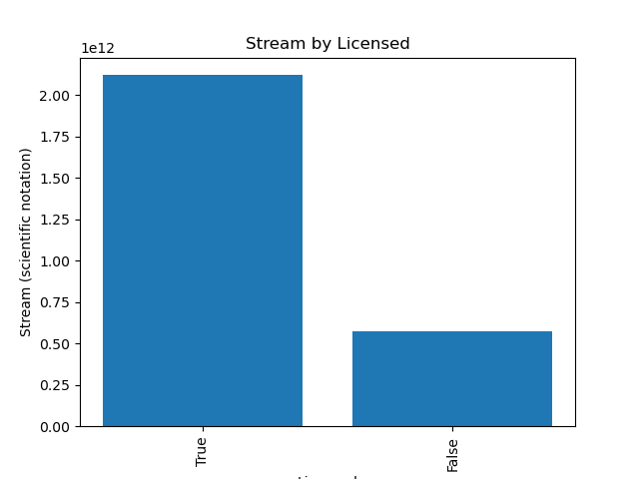
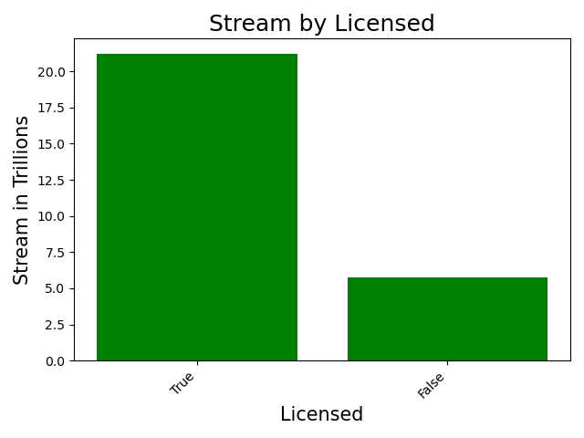
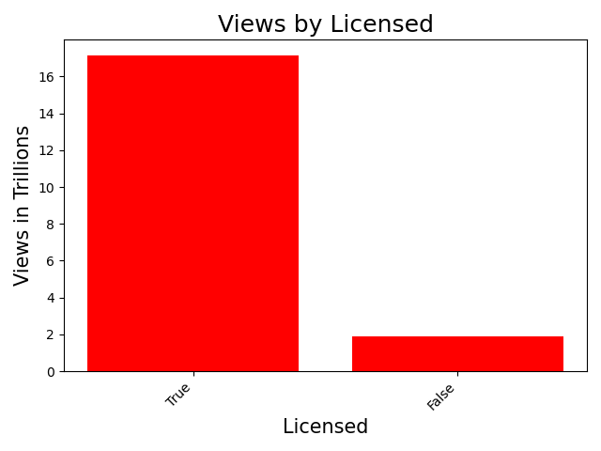
Do licensed songs have an effect on the popularity?
Songs that are licensed do better view and stream wise.

Slide 6
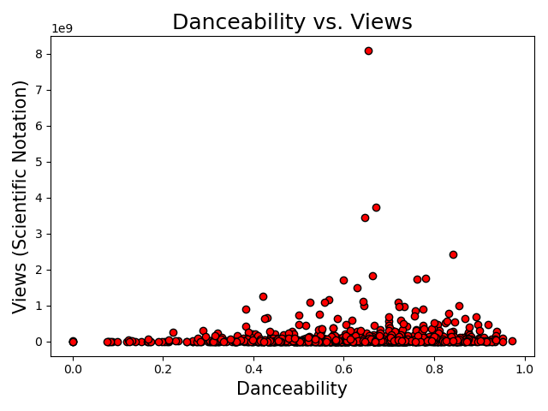
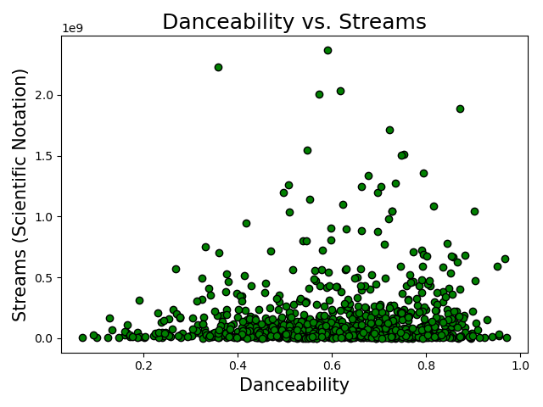
Danceability
(Does a song with high danceability make it more popular?)
Found through tempo, rhythm stability, beat strength etc.
The higher the danceability the more activity takes place.
Views seem denser towards the bottom of the graph
Pearson correlation coefficients: 0.08833
Pearson correlation coefficients: 0.0722

Slide 7
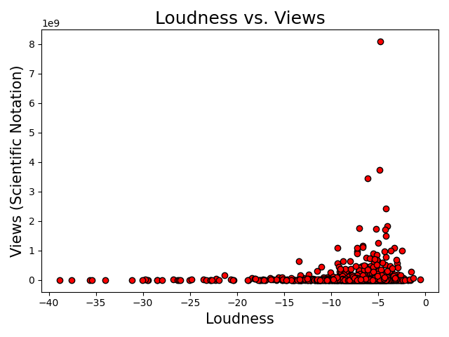
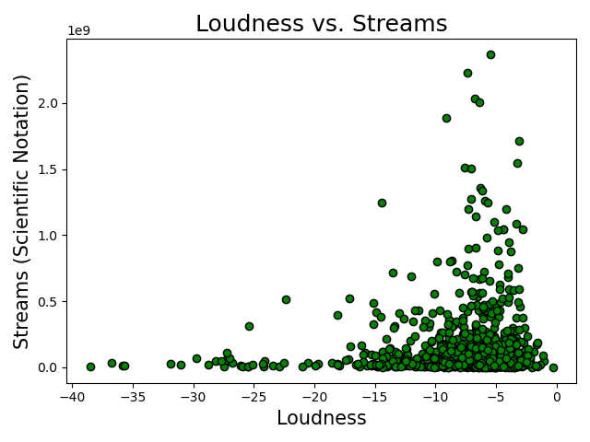
Loudness
(Do louder songs perform better on both platforms?)
Measured in decibels.
Averaged through the entire track
The louder the track, the more views and streams it seems to gain
Pearson correlation coefficients: 0.11868
Pearson correlation coefficients: 0.11904

Slide 8
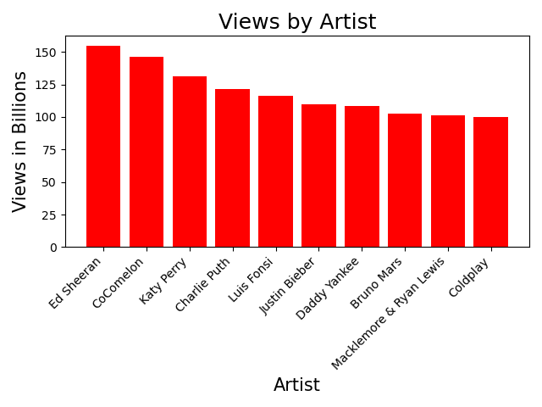
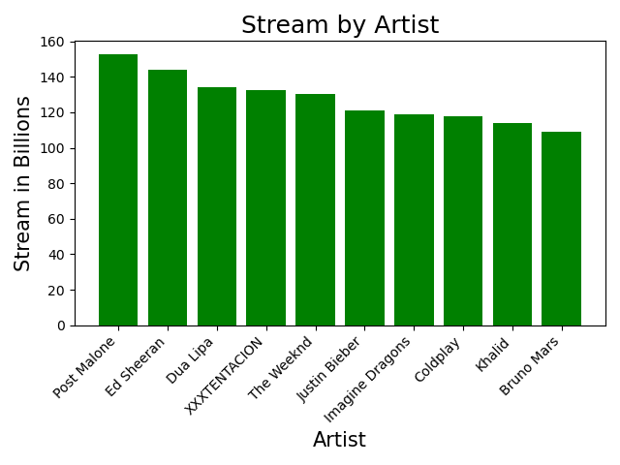
Can the same artist do well on both platforms?
Top two: Ed Sheeran and CocoMelon
Top artists work with more visuals
Top two : Post Malone and Ed Sheeran
Streams have no visuals

Slide 9
Overall Findings
Songs on Spotify/YouTube are more popular if they have the following characteristics:
Part of an album
Licensed
High danceability
High loudness
Usually an artist is not popular on both platforms

Slide 10
Limitations
The data set is heavily dependent on the time it was collected. All data was collected on February 7, 2023.
Only 10 songs of each artist were collected for this data set.
Limited to only variables collected

Slide 11
What could we have done to better our analysis
Collected more than 10 songs for each artist
Have our data set be collected on multiple days throughout the year
Collected data sets from different sources and merged

Slide 12
Resources
https://www.kaggle.com/datasets/salvatorerastelli/spotify-and-youtube
Images
https://www.vecteezy.com/vector-art/6642199-spotify-icon-spotify-logo-spotify-symbol-logo-set
https://www.freepik.com/free-photos-vectors/youtube-symbol

Slide 13
Feedback??

